Slide 1





Hiking Project
By Marcos, Abner and Sevda
A.K.A Los Polerones

Slide 2
Hiking Project
CONTENT
Our Objective
Queries
Structure

Slide 3
Hiking Project
CONTENT
Queries
Structure
Our Objective
Find the best experience / popularity from a particular hike.
This can come in the shape of showing, through queries, the best hikes to find cool bridges, snow, mortal accidents and the likes. All from personal experiences scraped from the web.
This will also have the added benefit of showing similarities between hikes.

Slide 4
Hiking Project
CONTENT
Our Objective
Structure
Queries
Which hiking is the best according to our preferences?
What is the overall feedback/sentiment for the selected hike? Can we get a rating that encompasses features from user’s real experience, updating seamlessly?
What can we expect from a particular hike? (Is it dangerous? What’s the weather like normally? …etc)

Slide 5
Hiking Project
CONTENT
Our Objective
Queries
Structure
We’ll now present out Theoretical DAG structure.
This means that the pipeline is subject to change according to challenges we find along the way and improvements or expansions that we want to include, and that we’ll of course have to adjust for offline use with python branch operators.

Slide 6









Hiking Project
Structure
Ingestion
Staging
Production
or

Slide 7
Hiking Project
Structure
We save the raw database into memory using Redis
Data Collection: Scraping the web
Data Cleansing: Clean data, star ranking and hour aggregating (modifying attributes).
Start
Scrape the Web (Save in Redis)
Clean Data
Save Data in Mongodb
Call Reddit API
(Save in Redis)
Perform NLP on Post data
Create Graph Database from DB in Neo4j
Create relationships from the NLP data in the graph database
End

Slide 8
Hiking Project
Structure
Data Ingestion: We save the cleaned data into Mongodb to provide flexibility when creating graph databases further on.
Data Enrichment: Reddit API to collect live / current information from user posts.
Start
Scrape the Web (Save in Redis)
Clean Data
Save Data in Mongodb
Call Reddit API
(Save in Redis)
Perform NLP on Post data
Create Graph Database from DB in Neo4j
Create relationships from the NLP data in the graph database
End

Slide 9
Hiking Project
Structure
Natural Language Processing (NLP)
Data enrichment as we analyse posts for keywords and create the columns / relationships.
We will expand the DAG to include sentiment analysis
Within this node we aggregate comments and decide the overall sentiment, thereby performing data reduction before once again enriching the final dataset.
Start
Scrape the Web (Save in Redis)
Clean Data
Save Data in Mongodb
Call Reddit API
(Save in Redis)
Perform NLP on Post data
Create Graph Database from DB in Neo4j
Create relationships from the NLP data in the graph database
End

Slide 10
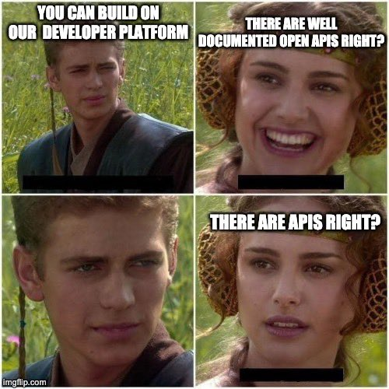
Hiking Project
Data Collection
Extract data from a pair of sources
As an example
We scrape a table from a hike enthusiast's website using beautiful soup to extract data from the HTML code.

Slide 11
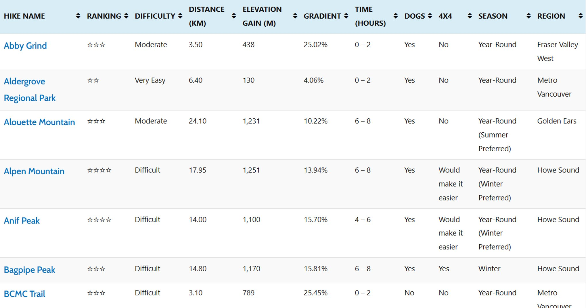
Hiking Project
Data Collection

Slide 12
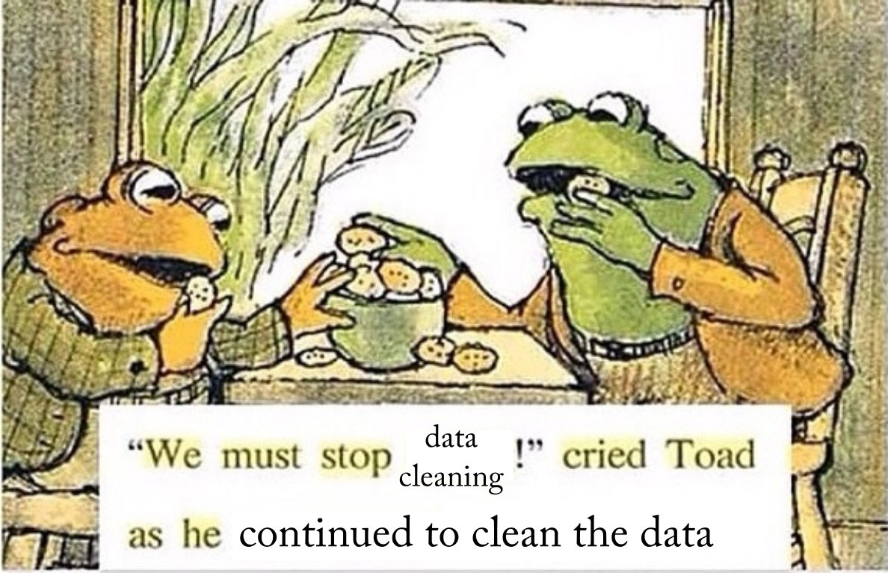
Hiking Project
Data Wrangling
Data Cleansing
Clean data, star ranking and hour aggregating (modifying attributes).
Data Enrichment
Perform NLP using SpaCy to determine the keywords of the posts in Reddit
Add new connections within the hike graph such as difficulty or season.

Slide 13
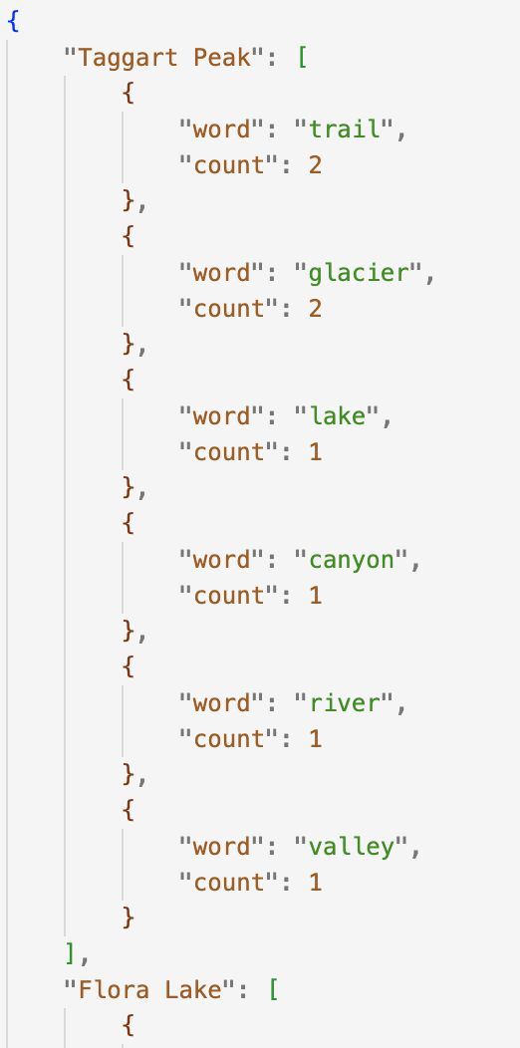
Hiking Project
Data Wrangling
Data Enrichment

Slide 14
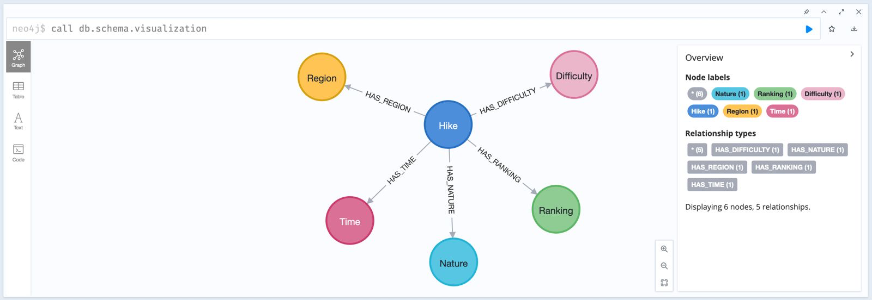
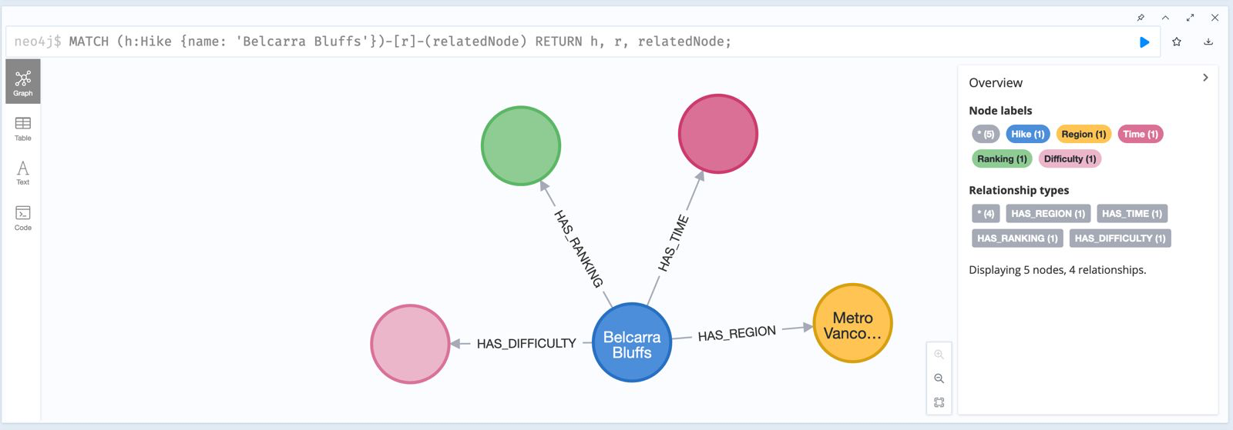
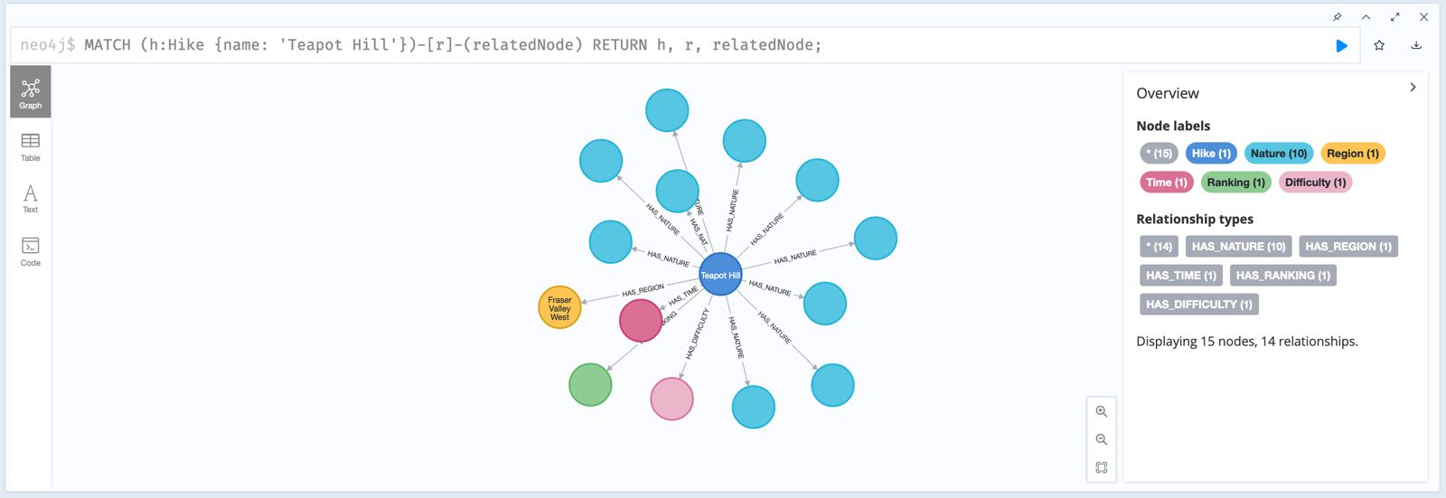
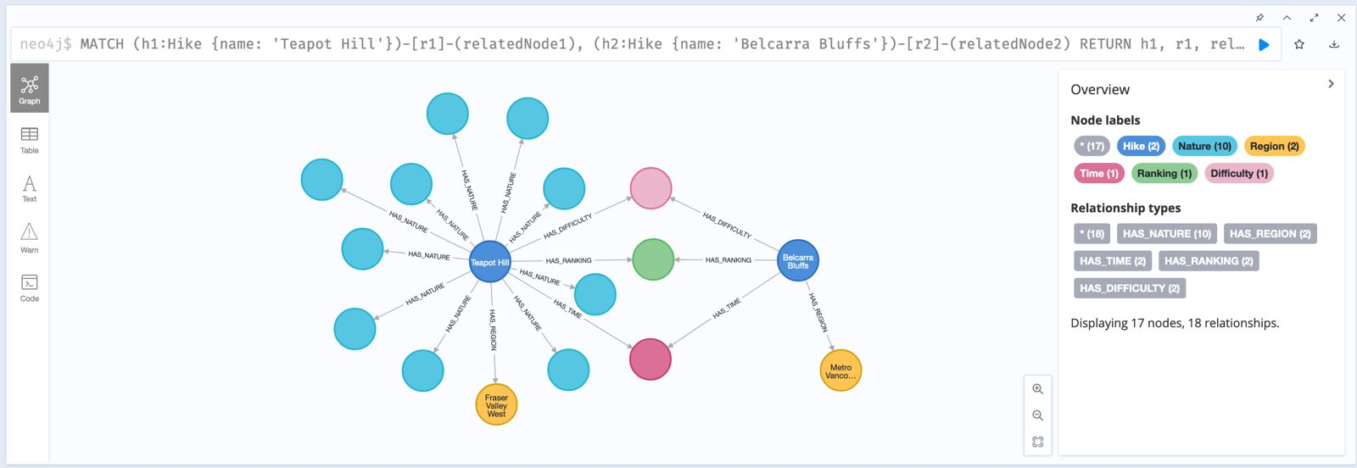
Hiking Project
Graph Structure
Note: Subject to change!
We chose to implement a Native Graph processing. We thought this would be the best for our project since our enrichment stage adds a lot of relationships, so we purpose built it to work with a graph structure.
The Collected and Ingested data from mongodb into te graph
Relationships created from the Data Enrichment process
The Graph Schema
The Graph Schema: An Example

Slide 15

Hiking Project
Graph Structure
The Collected and Ingested data from mongodb into the graph
Relationships created from the Data Enrichment process
The Graph Schema
The Graph Schema: An Example

Slide 16
Hiking Project
Future Considerations
Create a Postgres instance to store the production data.
Use Apache Kafka due to its efficiency in streaming processing, availability and fault intolerance storage which will be beneficial for our ingestion stage
Producers publish data to Kafka topics, and this data can then be consumed by downstream systems for processing
Create STAR Schema as the aggregation of all the steps in the pipeline in our Production stage
We might scrape a few more sources in the data collection stage to add more relevant data.

Slide 17
Hiking Project
Other Requirements
Launching docker containers via airflow to schedule job. This way, reddit posts can be the most up to date.
Offline use
Airflow + Pandas + Mongodb + Neo4j
Redis to speed up the workflow
Creativity from live reddit post enrichment
We’ll see if we have the time to implement kafka for the ingestion and staging steps.

Slide 18


Hiking Project
THANK YOU! :)

